Slide 1
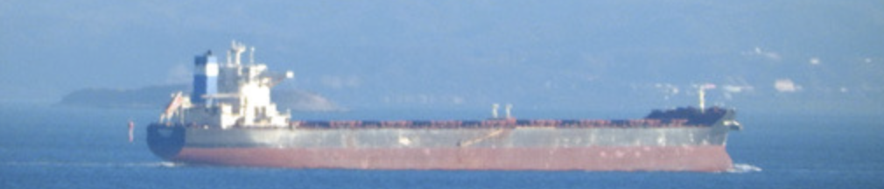

歌で学ぶ日本語
第4週、その1

Slide 2

JSIS events page for this event
Please view Andrew's pre-recorded lectures before the the Q&A event on Zoom (requires UW ID login): https://depts.washington.edu/llc/lr/media/view.php?id_file=25160 (Part 1) https://depts.washington.edu/llc/lr/media/view.php?id_file=25161 (Part 2) https://depts.washington.edu/llc/lr/media/view.php?id_file=25162
https://washington.zoom.us/my/aohta
Guest Lecture in Japan 344 on Monday
Notes:
Amy Snyder Ohta is inviting you to a scheduled Zoom meeting.
Topic: Amy's Winter quarter classes
Time: This is a recurring meeting Meet anytime
Join Zoom Meeting
https://washington.zoom.us/j/91617852059
Meeting ID: 916 1785 2059
One tap mobile
+12532158782,,91617852059# US (Tacoma)
+12063379723,,91617852059# US (Seattle)
Dial by your location
+1 253 215 8782 US (Tacoma)
+1 206 337 9723 US (Seattle)
+1 346 248 7799 US (Houston)
+1 602 753 0140 US (Phoenix)
+1 669 219 2599 US (San Jose)
+1 669 900 6833 US (San Jose)
+1 720 928 9299 US (Denver)
+1 971 247 1195 US (Portland)
+1 213 338 8477 US (Los Angeles)
+1 301 715 8592 US (Washington DC)
+1 312 626 6799 US (Chicago)
+1 470 250 9358 US (Atlanta)
+1 470 381 2552 US (Atlanta)
+1 646 518 9805 US (New York)
+1 646 876 9923 US (New York)
+1 651 372 8299 US (Minnesota)
+1 786 635 1003 US (Miami)
+1 267 831 0333 US (Philadelphia)
Meeting ID: 916 1785 2059
Find your local number: https://washington.zoom.us/u/aciBGQPrqp
Join by SIP
91617852059@zoomcrc.com
Join by H.323
162.255.37.11 (US West)
162.255.36.11 (US East)
221.122.88.195 (China)
115.114.131.7 (India Mumbai)
115.114.115.7 (India Hyderabad)
213.19.144.110 (Amsterdam Netherlands)
213.244.140.110 (Germany)
103.122.166.55 (Australia Sydney)
103.122.167.55 (Australia Melbourne)
209.9.211.110 (Hong Kong SAR)
149.137.40.110 (Singapore)
64.211.144.160 (Brazil)
69.174.57.160 (Canada Toronto)
65.39.152.160 (Canada Vancouver)
207.226.132.110 (Japan Tokyo)
149.137.24.110 (Japan Osaka)
Meeting ID: 916 1785 2059

Slide 3



水曜日のゲスト いわた先生
This Friday!

Slide 4
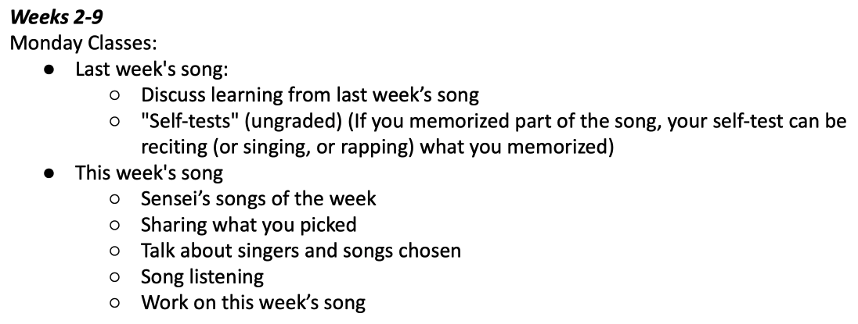
今日の授業のスケジュール
Various things to talk about/do in today’s class!
Oral の話をペアで話してください。

Slide 5

をしてみよう！

Slide 6


Slide 7
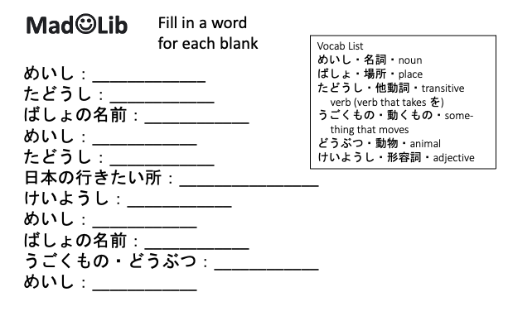
をしてみよう！
面白い言葉（ことば）を選んで（えらんで）ね！

Slide 8
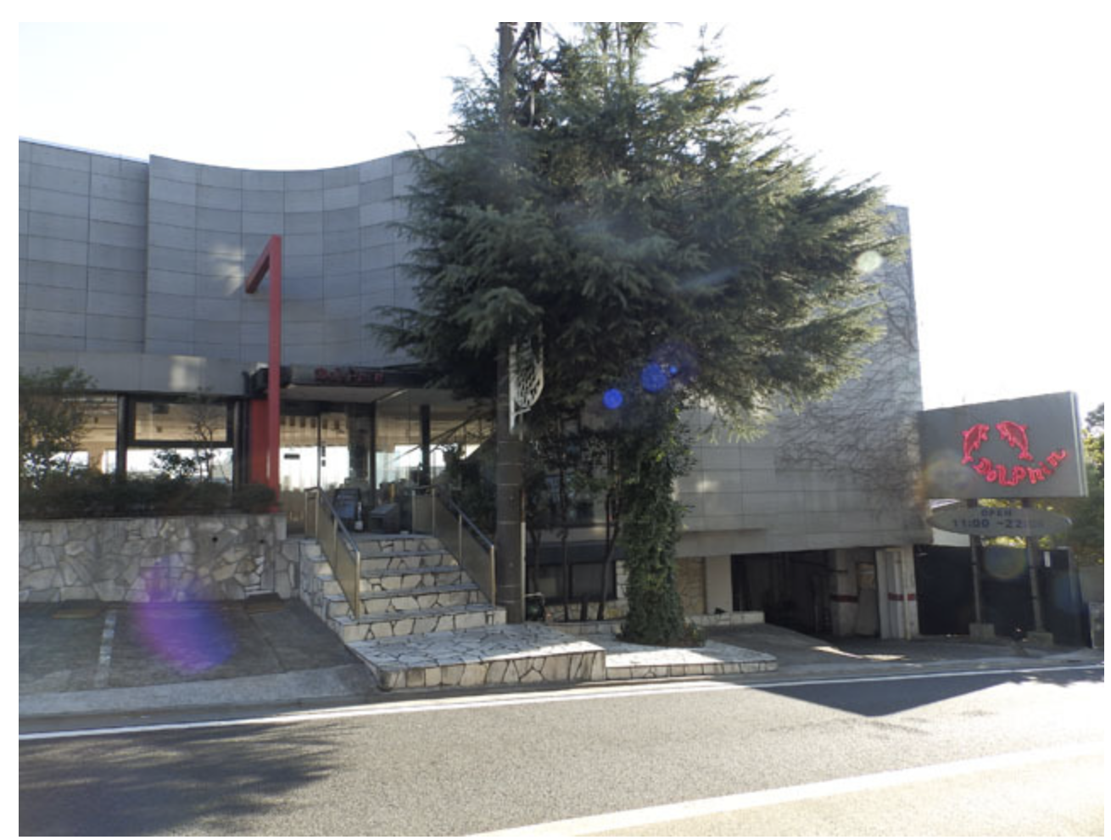
ドルフィン
Notes:
https://dailyportalz.jp/kiji/160219195764

Slide 9

ドルフィンのソーダ水

Slide 10
ドルフィンのテラスから見た貨物線

